Slide 1

Microsoft Ignite NZ
25-28 October 2016
SKYCITY, Auckland

Slide 2
My Other Computer is an Azure Datacentre
Ivan Towlson

Slide 3
Speed matters
Timely data
Rapid feedback
Hard deadlines

Slide 4
Big Compute
Traditional HPC (High Performance Computing)
Dedicated on-premise cluster
Cluster management/scheduling software
Microsoft implementation: Windows Server HPC Edition

Slide 5
Big Compute
HPC in the cloud
Traditional cluster management/scheduling software, running across machines in the cloud
Enables cloud burst and other hybrid scenarios
Microsoft implementation: HPC Pack

Slide 6
Big Compute
Big compute as a service
Capacity on demand
Scheduler hosted by service provider – no need for the user to run cluster manager or scheduler
Microsoft implementation: Azure Batch

Slide 7
Patterns
Parametric sweep
Monte Carlo
Divide and conquer
Analytics and reporting

Slide 8
Azure Batch architecture
Jobs and tasks – work to be done
Pools and nodes – where to do that work

Slide 9
Azure Batch architecture
Windows (PaaS and IaaS)
Linux (IaaS)
Batch Shipyard – deployment via Docker

Slide 10
Demos
Parallelising work to finish quicker (BLAST)
Distributed deep learning (TensorFlow)

Slide 11
Challenges and lessons learned
Data movement
Inter-node communication
Capacity and spin-up time
Batch vs. interactive
Security boundaries

Slide 12
Ecosystem
Azure Data Factory (orchestration)
Azure Data Lake (big data)
Azure IoT (good candidate for parallel processing)
ExpressRoute (data movement, bridge to on-premise)

Slide 13
Thanks!
Compute tasks don’t have to take ages
Faster turnaround is better for business and people
Many patterns scale naturally out and/or up
More and bigger machines are there for the taking
itowlson@microsoft.com | ivan@hestia.cc
hestia.typepad.com/flatlander | @ppog_penguin
github.com/itowlson/my-other-computer

Slide 14
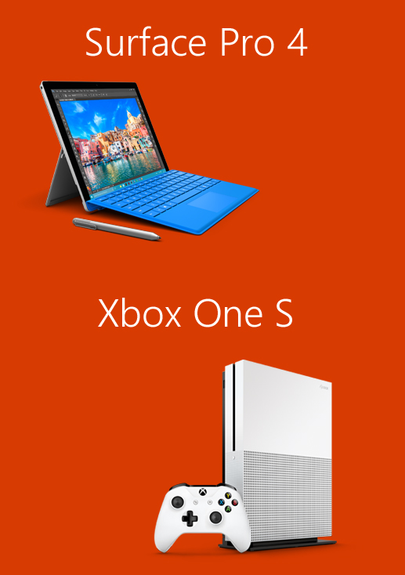
Please evaluate this session for the chance to instantly win great prizes like Surface Pro 4 and the brand new Xbox One S!
Your feedback is important to us!
From your PC or Tablet visit My Ignite at http://msignite.nz/my-ignite

